Slide 1

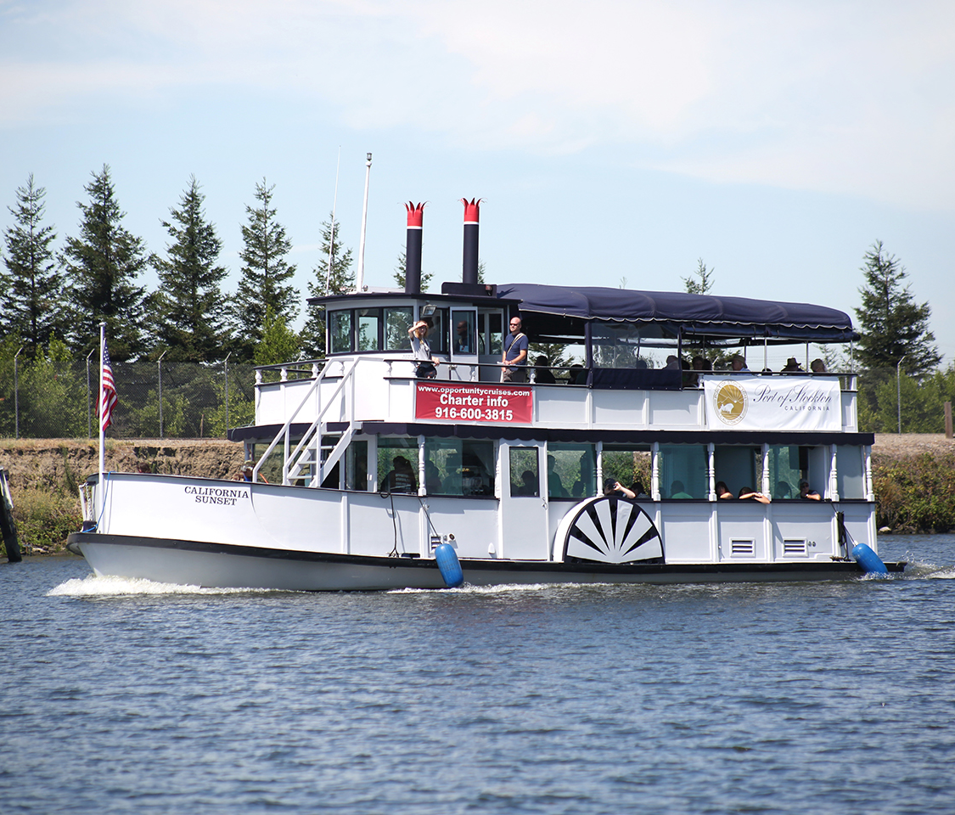
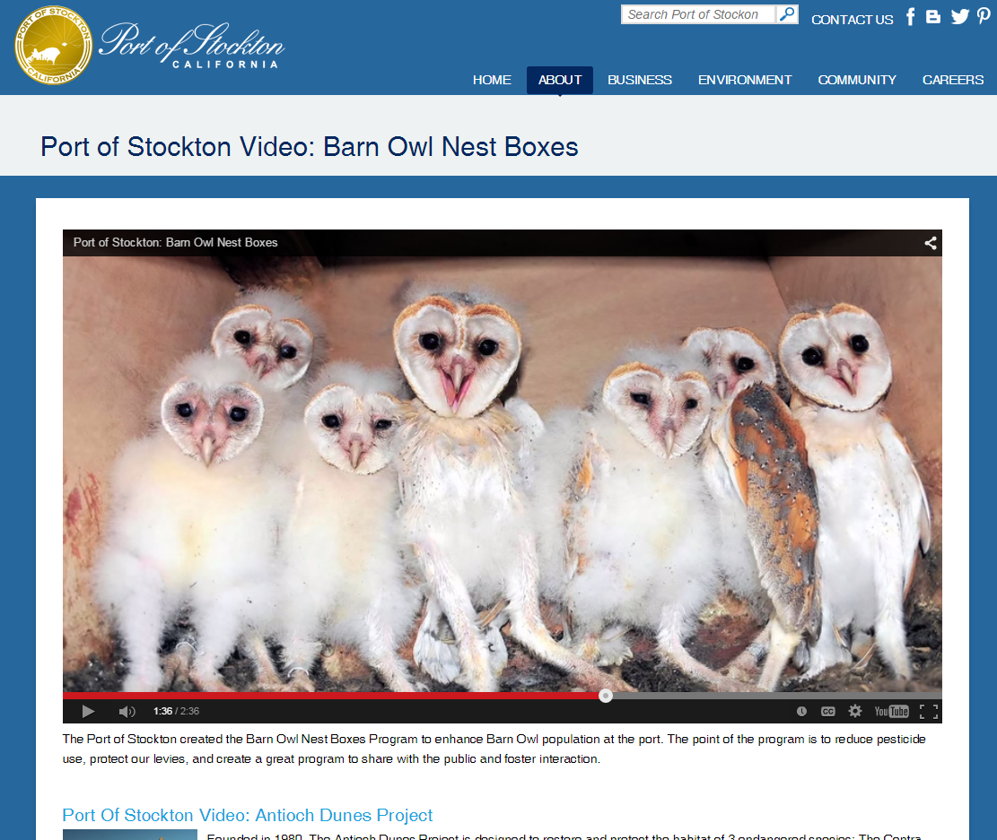

Port of Stockton
Community & Environmental Initiatives
Use this area for image(s) placement.
Delete this text box before placing image(s).
Please limit image file size to more than 1 MB.
Videos
Use this area for logo
(delete text box before placing logo)

